Slide 1
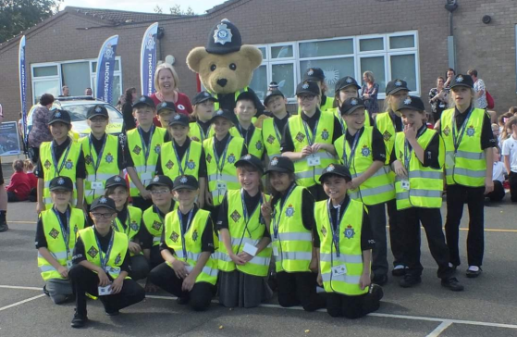
Nottinghamshire Mini Police

Slide 2
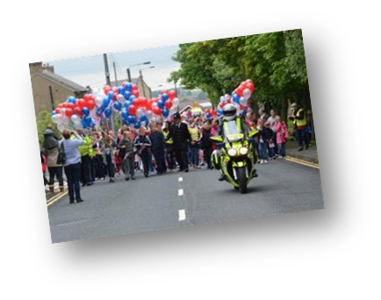
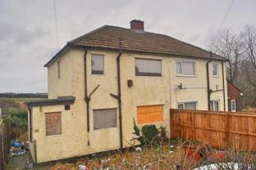
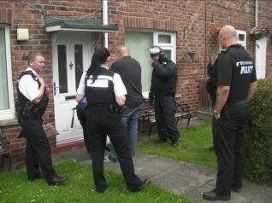
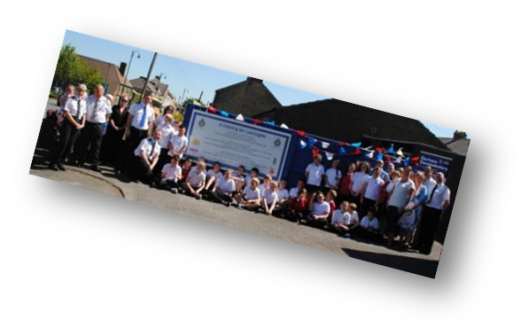
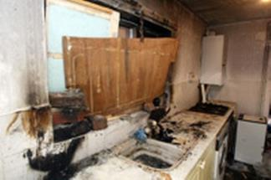
Background
2011 – Idea in NW Durham
2012\15 – Durham Constabulary Expansion
2015\17 – Expansion to 6 Forces
2017 – Partnership with VPC – National Expansion
2018 – Nottinghamshire Police launched within 3 schools

Slide 3
Objectives and Aims
Inspire trust and confidence
Helping to protect communities and the vulnerable
Communicate to reassure communities
Early Intervention
Long term problem solving
Demand reduction
Inclusion and engagement

Slide 4
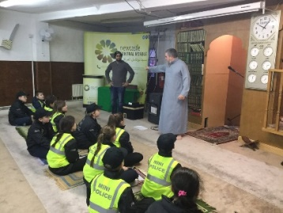
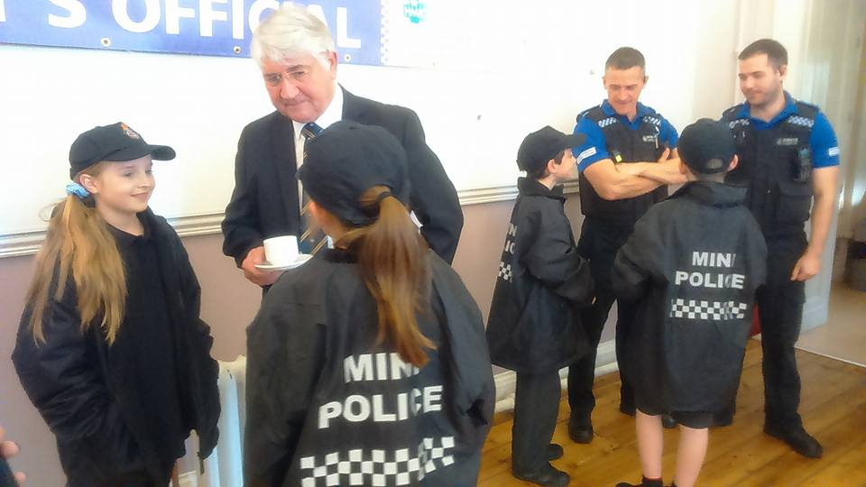
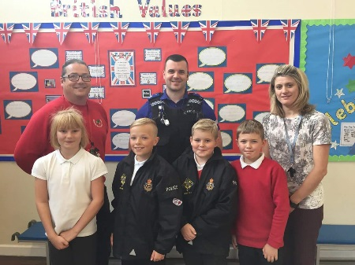
How does the Mini Police fit into Education Priorities
There are countless benefits from investment in a Mini Police programme both direct and indirect
Ofsted
Helps develop aspirations and educational attainment
British Values
#iwill campaign
Positive life changing experience by children, which builds trust & confidence
Children experience positive early interaction with the Police Service
Inclusion and interaction with other school children within Nottinghamshire, feeling part of a wider team
Positive life changing experience by the children involved

Slide 5
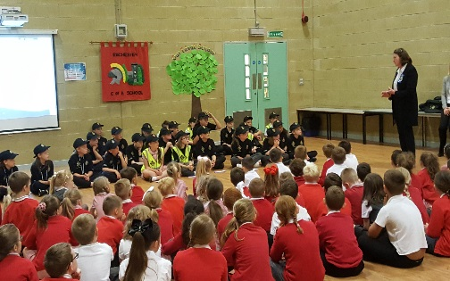
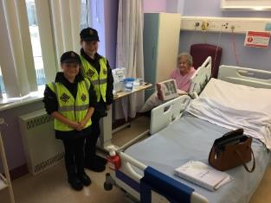
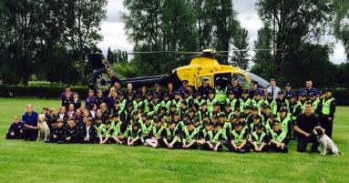
Nottinghamshire Mini Police
What is the Mini Police?
The programme engages with children in Year 5/6 in an educational and interactive way, with the emphasis being that the children have fun, whilst learning about their community, how to keep safe and also about the police. The programme involves the children being visited in school by our police team and also going to other locations.
It will consists of 3 engagements per a term
Education Led
Community Led
Reward Led

Slide 6
How does it work?
Consideration is given to the staffing of the programme.
Schools will be asked to set up a Mini Police club either a lunch time club/after school club to reinforce the engagement process and community ownership
A Mini Police noticeboard should be placed in a prominent place within the school.
Schools will be given as much notice as possible for up and coming events, such as guest speakers and we encourage the schools to make the necessary arrangements to make these interactions possible.
The Mini Police will deliver safety messages to the school through school assemblies.
Open communication between the school’s PCSO and Mini Police coordinator is key to a successful scheme.

Slide 7
Nottinghamshire Mini Police
Activities and Events
Most of the activities the Mini Police undertake will take place within school term time and within school hours. There will be events and activities held around Nottinghamshire to allow for the children to receive a full experience.
However, there maybe odd events within the community that require them to attend events in an evening and at weekends. We anticipate this to be required infrequently. Parents/carers will be required to attend events outside school with their child. This is to ensure if officers are required to deal with incidents when out within the community, your child is cared for. All risk assessments are completed fully before any event.
The children will be provided with a Mini Police Uniform to wear whilst taking part in events. This uniform will remain the property of the Nottinghamshire Police. This will consist of a polo shirt, waterproof jacket, hi-viz Vest and a cap.

Slide 8
Feedback
At the end of each term you will be provided with a short survey allowing us to access and evaluate the scheme.
We, being the staff, children and parents feel very proud to be part of the Mini Police. This programme has brought
excitement into our school about the police force. Children now talk very positively about the police
Julie – Teacher
One Year 6 teachers has
commented on how
much confidence one of her
boys now has due to the Mini
Police and that he has
really come out of
himself in his new role
- Anna
The visit to the Central Mosque was extremely informative and provided children
with invaluable experiences of different beliefs and cultures
Neil Bell – Deputy Head
What an experience we had
Julie Corrigan - Teacher

Slide 11
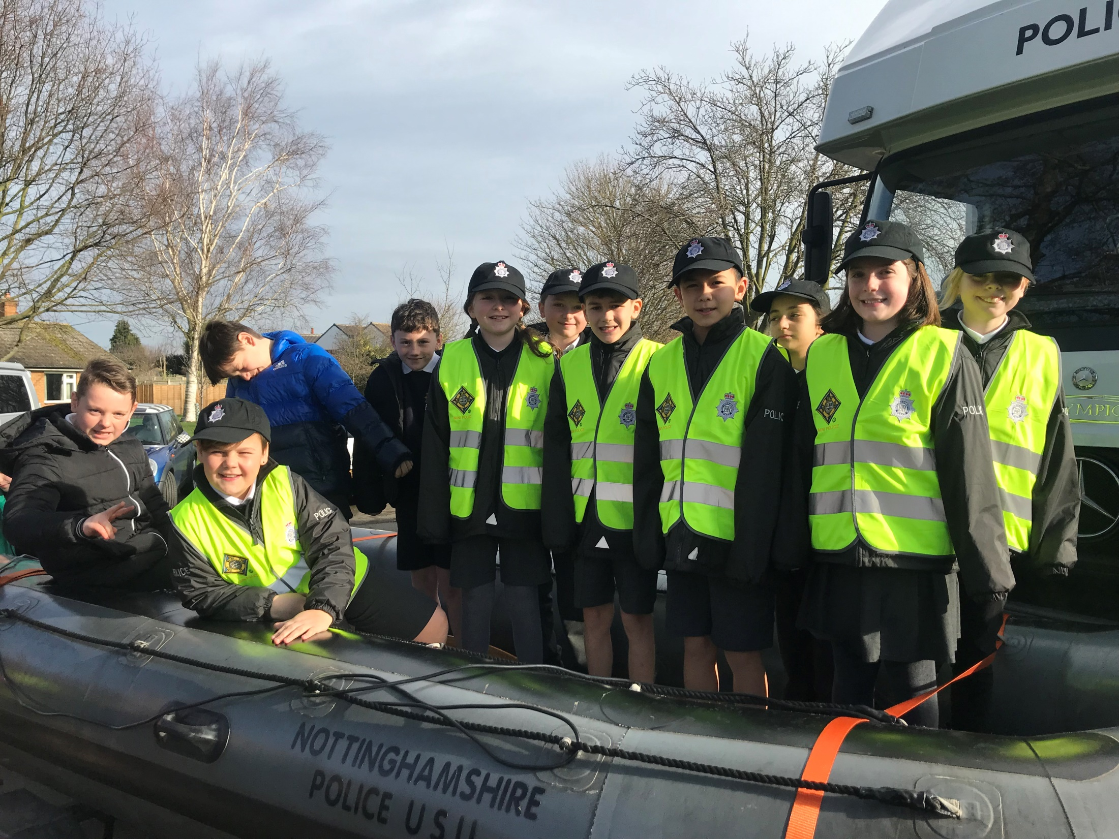

Slide 12
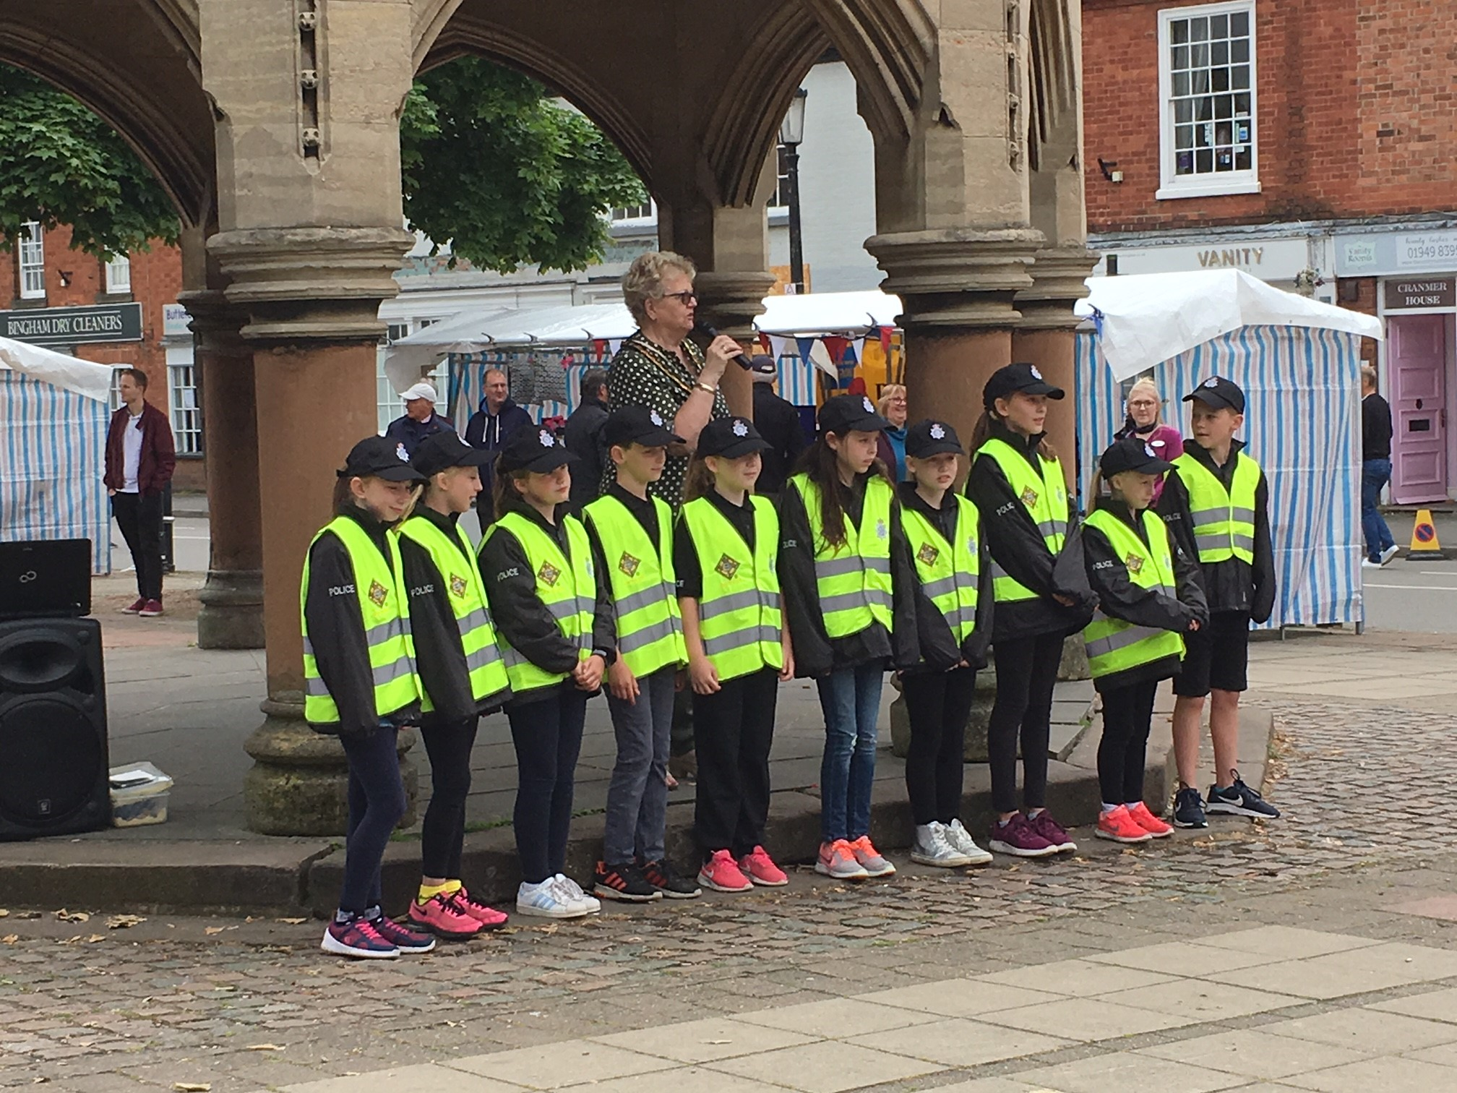

Slide 13
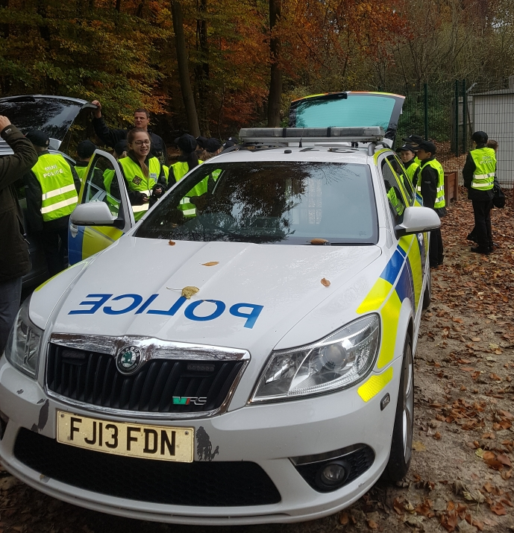

Slide 14
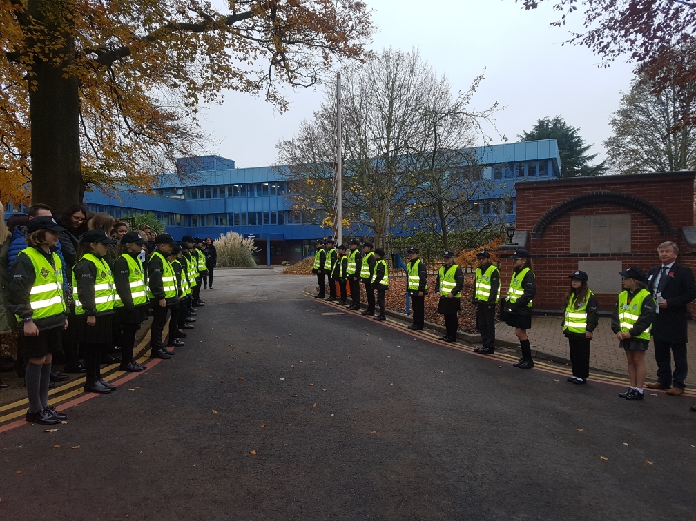

Slide 15
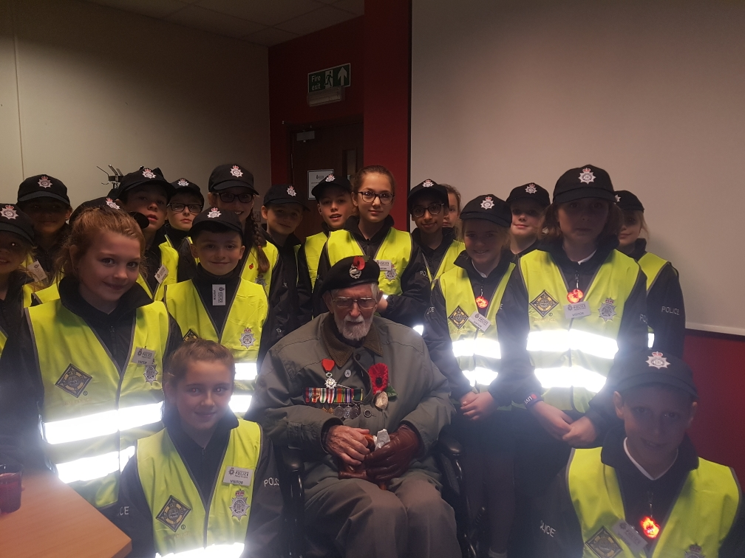

Slide 16
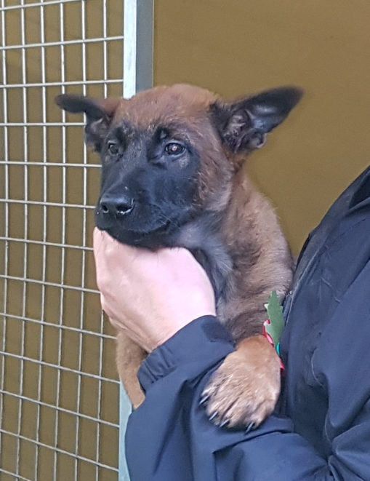
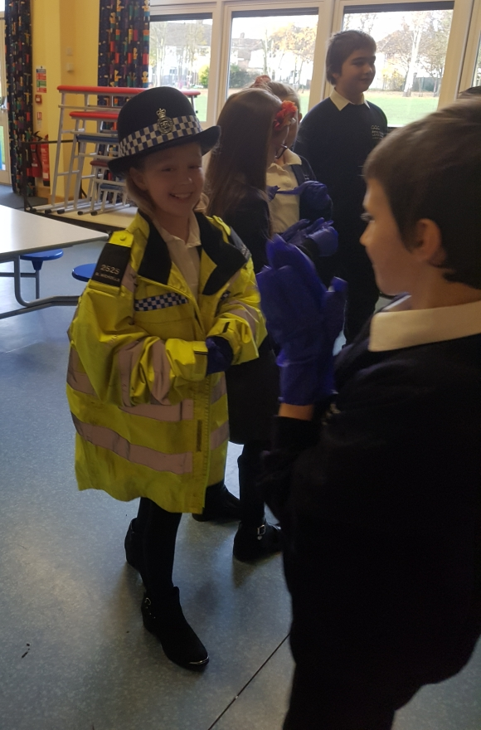

Slide 17
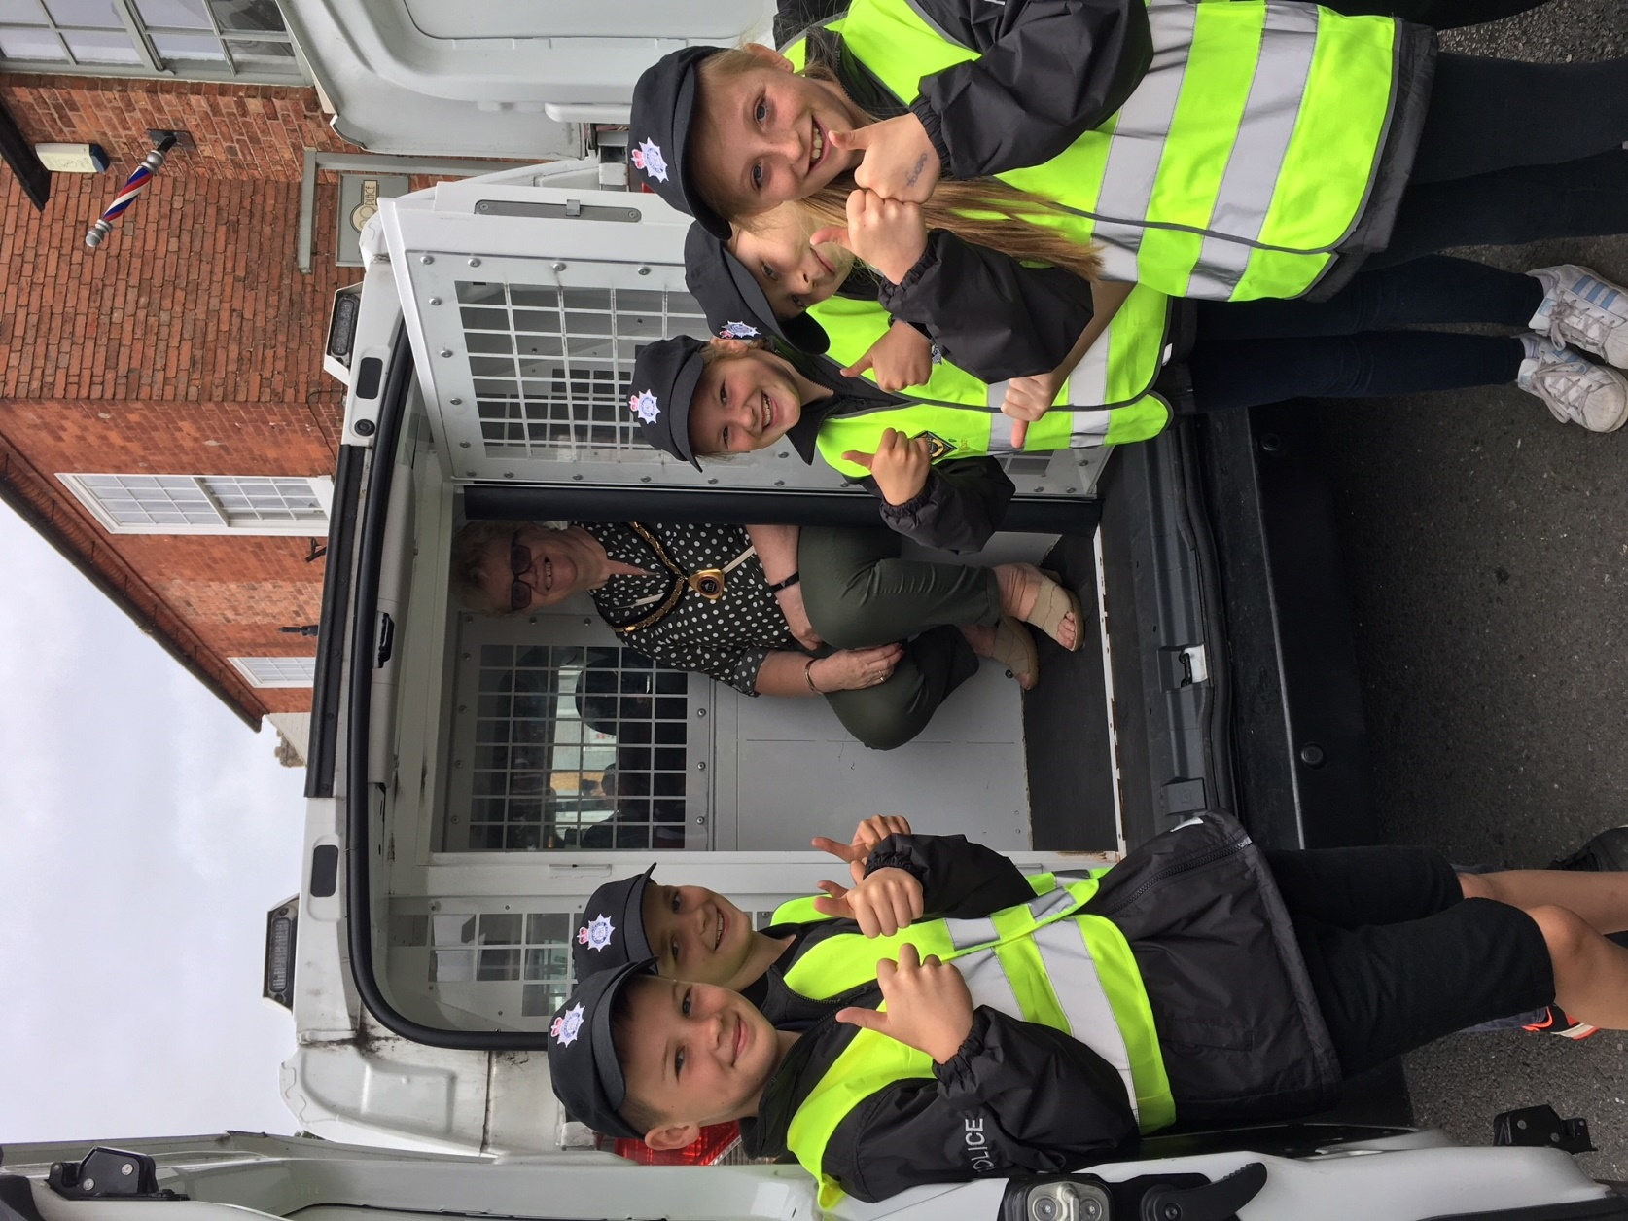

Slide 18
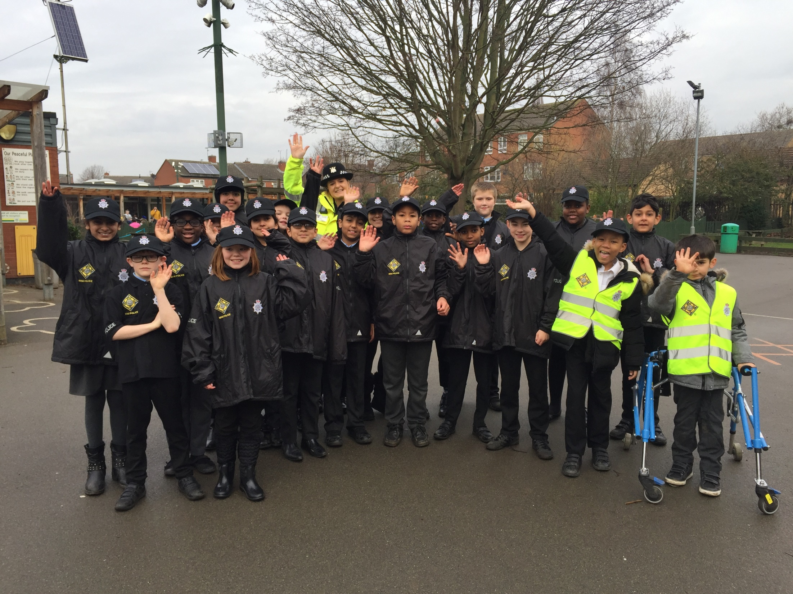

Slide 19
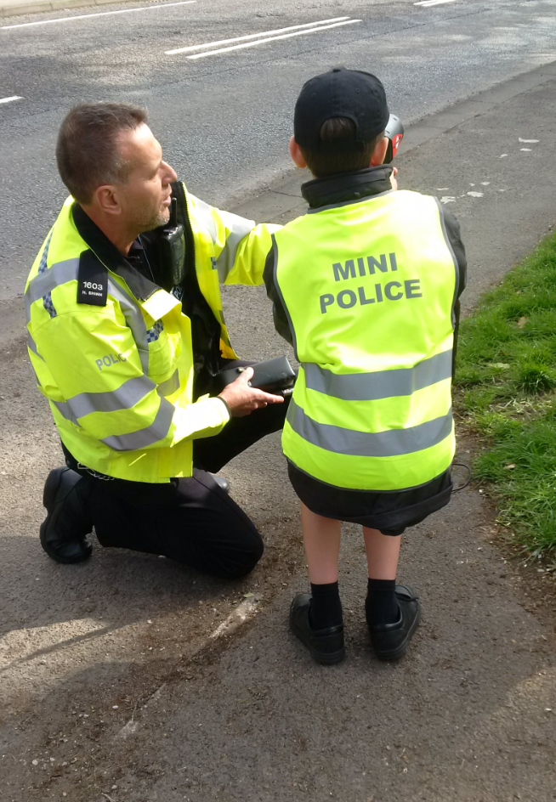

Slide 20
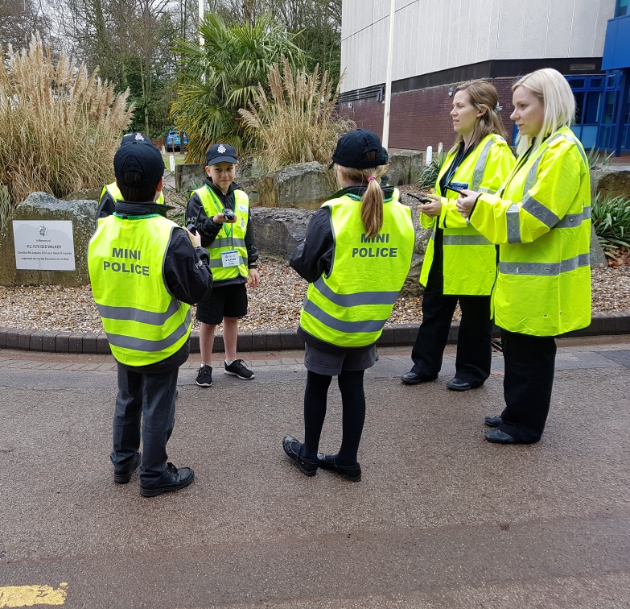

Slide 21
